Slide 1
Manifesto for Labour Law
towards a comprehensive revision of workers’ rights

Slide 2
Sectoral collective bargaining
Giving workers a voice

Slide 3
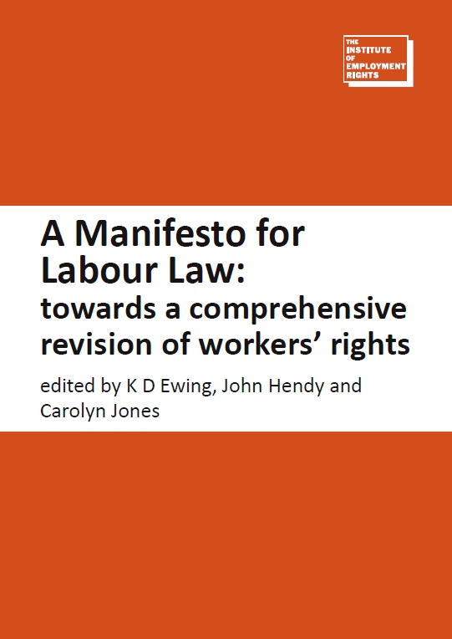
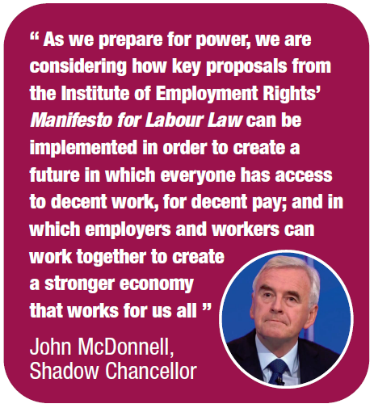
Manifesto for Labour Law
Notes:
The Institute of Employment Rights’ Manifesto for Labour Law: towards a comprehensive revision of workers’ rights was published in June 2016
It was drafted by 15 leading labour lawyers and academics
It comprises 25 recommendations for reform with the overarching aim to shift the focus of labour law away from individual rights to collective ones
So far, 14 major unions have announced their support, as well as the TUC
The Labour Party has adopted the Manifesto as a blueprint for its future employment law reforms
In this presentation we will explore the need for, and benefits of, one of our proposals – the reinstatement of sectoral collective bargaining

Slide 4
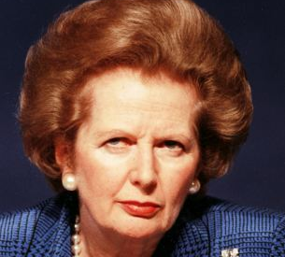
Thatcher’s legacy
Thatcher administration reframed labour law as a set of individual rather than collective rights, and weakened trade union power
Notes:
Trade unions less able to protect workers from exploitation, membership levels fall
Workers less able to protect themselves on an individual basis:
Terms and conditions imposed unilaterally by employers
Access to justice – awareness of rights, non-payment of compensation, fees
‘Worker’ vs ‘employee’ structure
Employers take advantage of ‘Wild West’ – Zero-hour contracts, bogus self employment

Slide 5
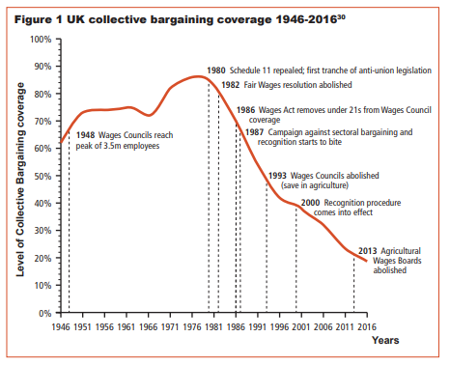
Impact: collective bargaining coverage plummets

Slide 6
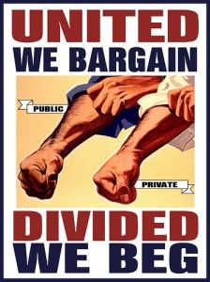
Impact: workers have no leverage against powerful employers

Slide 7
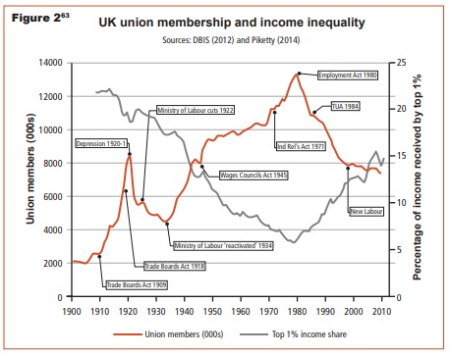
Impact: income inequality soars to highest level for >75 years

Slide 8
Quiz: collective bargaining
What is the EU average for collective bargaining coverage?
47%
56%
60%
63%

Slide 9
Quiz: collective bargaining
What is collective bargaining coverage in the UK?
29%
33%
47%
52%

Slide 10
Quiz: inequality
How much more does the average FTSE CEO take home than a worker on the ‘National Living Wage’?
139 times more
214 times more
298 times more
386 times more

Slide 11
Quiz: inequality
How many people own 40% of the wealth in the UK?
1 million
100,000
10,000
1,000
0.002% of the population

Slide 12
Sectoral collective bargaining
Manifesto proposal: Reinstate sectoral collective bargaining – adopted by Labour Party in For the many, not the few
Sectoral Employment Commissions (SECs) overseen by the Ministry of Labour
Sectoral collective agreement set minimum terms
Enforced by agreed mechanisms, Labour Inspector, or Labour Courts

Slide 13
Benefits – Voice at Work
Notes:
Maina Kiai, ILO: “Labour rights are human rights, and the ability to exercise these rights in the workplace is prerequisite for workers to enjoy a broad range
of other rights, whether economic, social, cultural, political or otherwise”
UK workers spend almost a quarter of their working-age lives in the workplace
Democracy should not stop at the gates to the workplace
Involvement of workers in decision making by their employers has been shown to be highly beneficial to business

Slide 14
Benefits – More money; more jobs
Increase in real value of wages for the first time since 2007
Stimulation of economy leads to creation of new jobs, better-quality jobs
Reduction in inequality (and associated social problems, inc. health, life expectancy, living standards)
Net gain to public purse
More tax revenue
Less subsidising of low wages through welfare state

Slide 15
Benefits – Economic productivity
Notes:
Professor Ozlem Onaron, Economist, University of Greenwich - “Legal restrictions on the ability of trade unions [to operate], where these bite sufficiently to reduce their bargaining capacity, are contrary to good economic policymaking where countries are in wage-led growth regimes, and where labour’s share of income has declined. Economic recovery and stable, equitable development needs a rise in the collective voice of labour."
Competition based on investment in upskilling staff and product/service innovation
Greater commitment to job among workers

Slide 16
Benefits – The rule of law
Notes:
Collective bargaining is a fundamental human right protected by international laws ratified by the UK
ILO Convention No.98 – “to encourage and promote the full development and utilisation of [collective bargaining] machinery”

Slide 17
What we could achieve
In 1979:
Collective bargaining coverage was 82%
Top 10% held 21% of wealth (compared with 45% in 2010)
European countries with high levels of sectoral collective bargaining
Denmark, Sweden, Finland, Belgium, France, Austria, Germany, Portugal, Slovenia
All have significantly lower income inequality than the UK, with Sweden and Slovenia the most equal countries in the EU

